Slide 1
DISCRETE MATHEMATICAL STRUCTURES
UNIT I (9 Hrs)
Fundamental Principles of Counting and Combinatorics:
The Rule of Sum and Product, Permutations, Combinations, Principle of Inclusion and Exclusion, Derangements, The Binomial Theorem, Combinations with repetition
Recursive Definitions, Recurrence Relations:
Recursive definition, First order linear recurrence
relation- Formulation problems and examples, Second order linear recurrence relations with constant coefficients- Homogeneous and Non homogeneous, Generating functions
(https://www.youtube.com/watch?v=QaAQ-bKCUME), (https://www.youtube.com/watch?v=eAaP4XaB8hM)

Slide 2
Fundamental Principles of Counting:
The Rule of Sum and Product
Permutations
Combinations
The Binomial Theorem
Combinations with repetition

Slide 3
Fundamental Principles of Counting:
Enumeration or counting is an obvious process when first studying arithmetic.
Applications of Enumeration
Coding Theory
Probability
Statistics
Analysis of algorithms

Slide 4
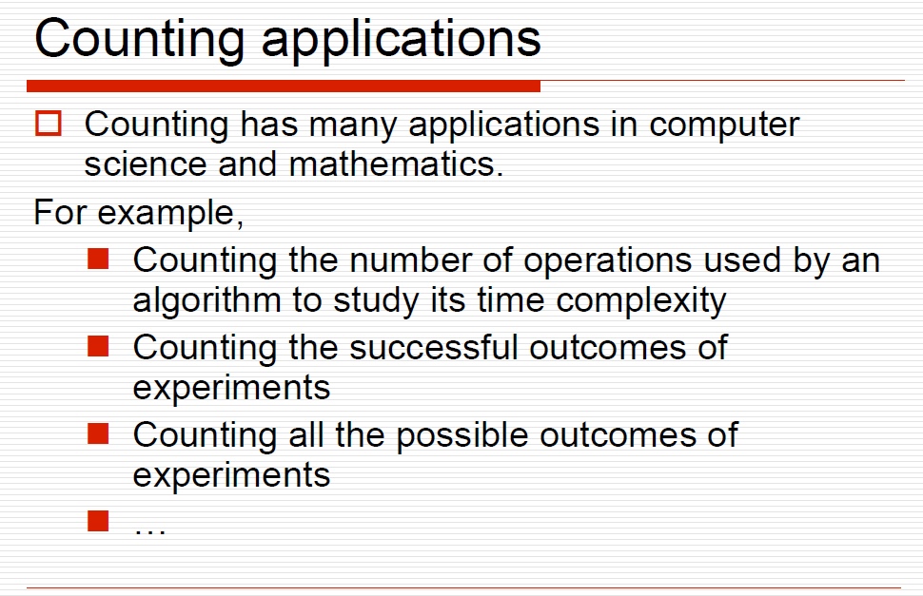
Fundamental Principles of Counting:

Slide 5
Fundamental Principles of Counting:
1.1 The Rules of Sum and Product
problem → decompose → combine
The Rule of Sum
If a first task can be performed in m ways, while a second task can be performed in n ways, and the tasks cannot be performed simultaneously, then performing either task can be accomplished in any one of
m+n ways.

Slide 6
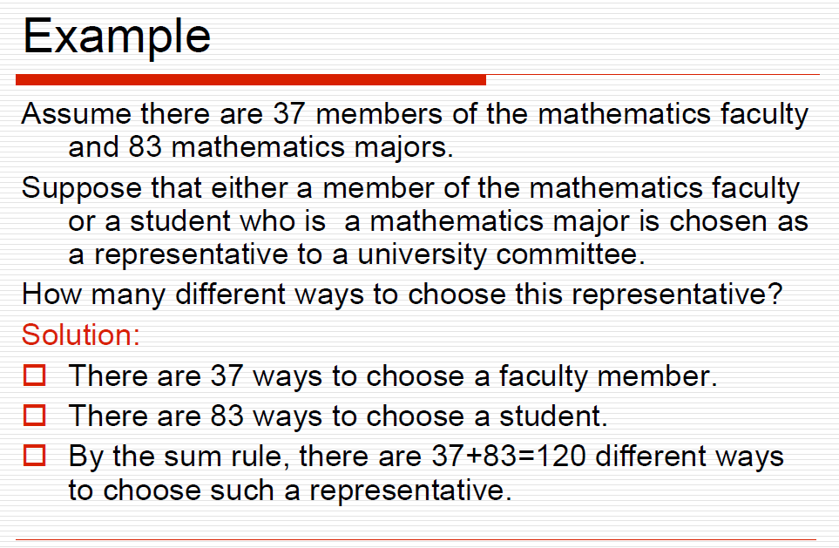
The Rules of Sum and Product

Slide 7
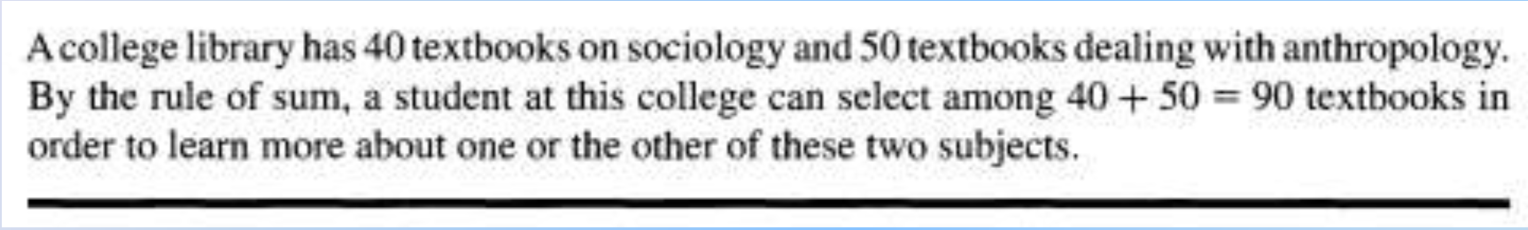
The Rule of sum
To select 1 book: 40+50 =90 choices

Slide 8
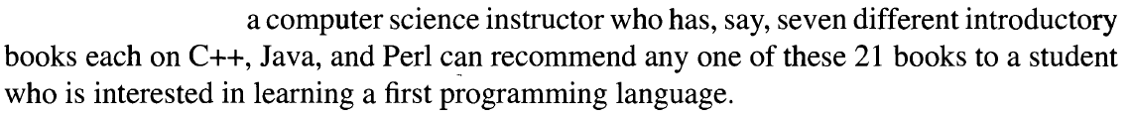
The rule of Sum

Slide 9
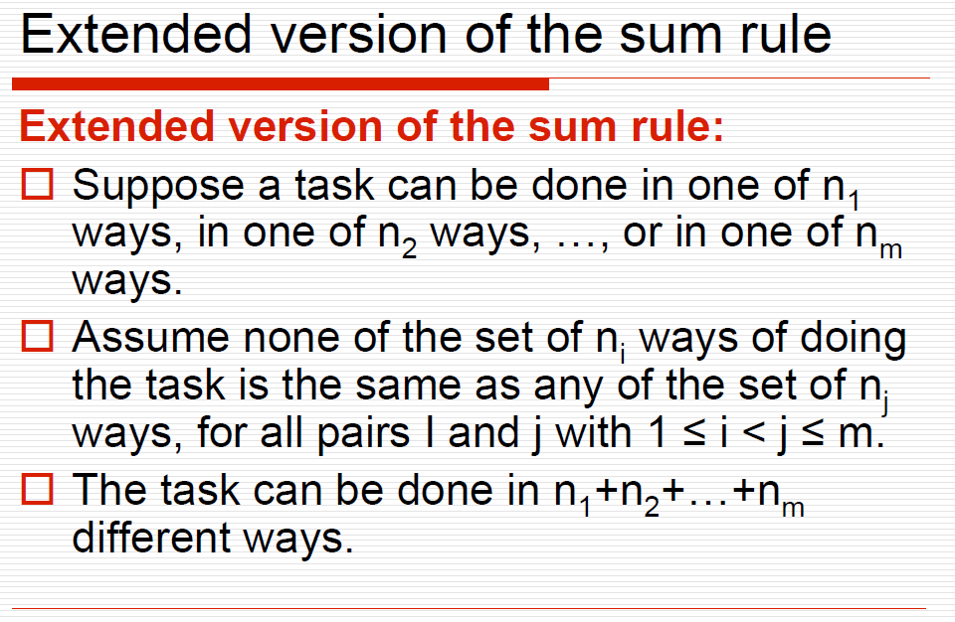
The rule of Sum

Slide 10
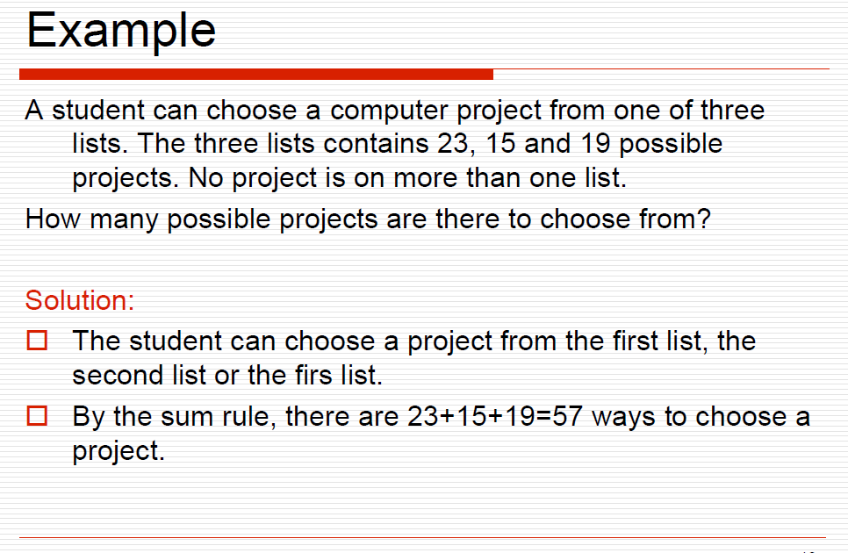
The rule of Sum

Slide 11
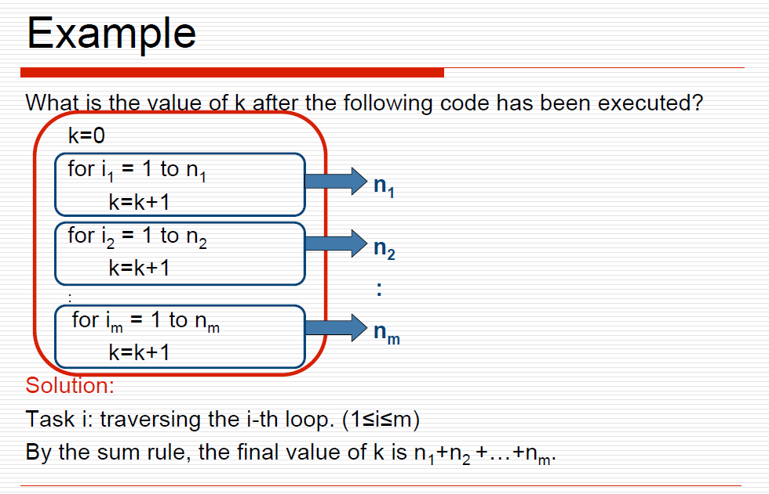
The rule of Sum

Slide 12
Fundamental Principles of Counting:
The rule of product :
If a procedure can be broken down into first and second stages, and if there are m possible outcomes for the first stage and if, for each of these outcomes, there are n possible outcomes for the second stage, then the total procedure can be carried out, in the designated order, in mn ways.

Slide 13
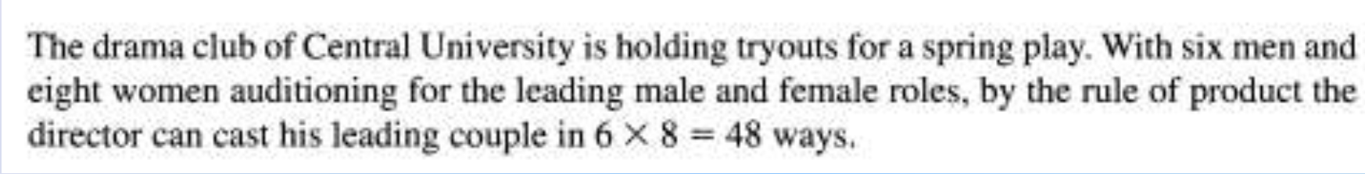
Fundamental Principles of Counting:
The rule of product :

Slide 14
Fundamental Principles of Counting:
The rule of product :
How many possible outfit combination can you form if you have 4 shirts and 3 pairs of jeans?

Slide 15
Fundamental Principles of Counting:
The rule of product :
How many possible outfit combination can you form if you have 4 shirts and 3 pairs of jeans?
12

Slide 16
Fundamental Principles of Counting:
The rule of product :
A restaurant offers 5 appetizers, 20 main courses and 10 desserts. In how many ways can you order a 3- course meal?

Slide 17
Fundamental Principles of Counting:
The rule of product :
A restaurant offers 5 appetizers, 20 main courses and 10 desserts. In how many ways can you order a 3- course meal?
5 x 20 x 10 = 1000

Slide 18
Fundamental Principles of Counting:
The rule of product :
In how many ways can a car be ordered if there are 5 possible colors, if it is automatic or standard, if it is powered by gas, electric or hybrid, and if it comes with or without GPS?

Slide 19
Fundamental Principles of Counting:
The rule of product :
In how many ways can a car be ordered if there are 5 possible colors, if it is automatic or standard, if it is powered by gas, electric or hybrid, and if it comes with or without GPS?
5 x 2 x 3 x 2 = 60 ways

Slide 20
Fundamental Principles of Counting:
The rule of product :
You are taking a 10-item quiz with 5 possible choices. If you leave nothing blank, in how many ways can you answer the quiz?

Slide 21
Fundamental Principles of Counting:
The rule of product :
You are taking a 10-item quiz with 5 possible choices. If you leave nothing blank, in how many ways can you answer the quiz?
9765625 (5 exp 10 )

Slide 22
Fundamental Principles of Counting:
The rule of product :
Telephone numbers in the US begin with 3-digit area codes followed by 7-digit local telephone numbers. Area codes and local telephone numbers cannot begin with 0 or 1. How many different phone numbers are possible?

Slide 23
Fundamental Principles of Counting:
The rule of product :
Telephone numbers in the US begin with 3-digit area codes followed by 7-digit local telephone numbers. Area codes and local telephone numbers cannot begin with 0 or 1. How many different phone numbers are possible?
6 40,0 0,00 ,000 (8X8 x10 exp 8)

Slide 24
Fundamental Principles of Counting:
The rule of product :
A license plate consists of two letters followed by four digits.
(i) If no letter or digit can be repeated?

Slide 25
Fundamental Principles of Counting:
The rule of product :
A license plate consists of two letters followed by four digits.
(i) If no letter or digit can be repeated?

Slide 26
Fundamental Principles of Counting:
The rule of product :
A license plate consists of two letters followed by four digits.
(ii) If repetitions of letters and digits are allowed?

Slide 27
Fundamental Principles of Counting:
The rule of product :
A license plate consists of two letters followed by four digits.
(ii) If repetitions of letters and digits are allowed?

Slide 28
Fundamental Principles of Counting:
The rule of product :
A license plate consists of two letters followed by four digits.
(iii) If repetitions of letters and digits are allowed,
how many of the plates have only vowels and
even digits ?

Slide 29
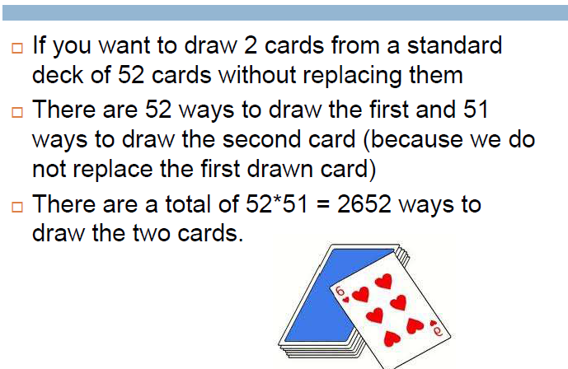
Fundamental Principles of Counting:

Slide 30
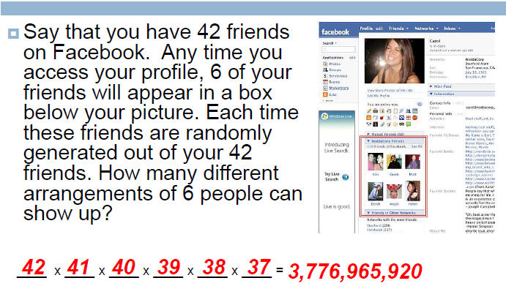
Fundamental Principles of Counting:

Slide 31
Fundamental Principles of Counting:
The rule of product :
In some simple computers, one-byte address is used to identify the cells in main memory.
Some uses two-byte address.
Some uses four-byte address.
Some even uses eight-byte address.

Slide 32
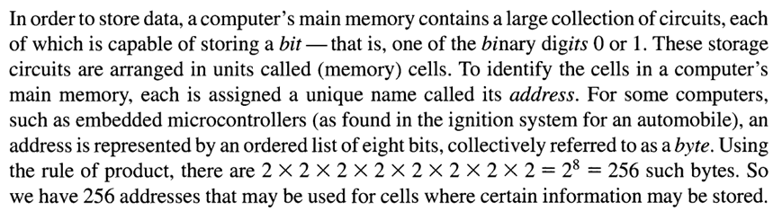
Fundamental Principles of Counting:

Slide 33
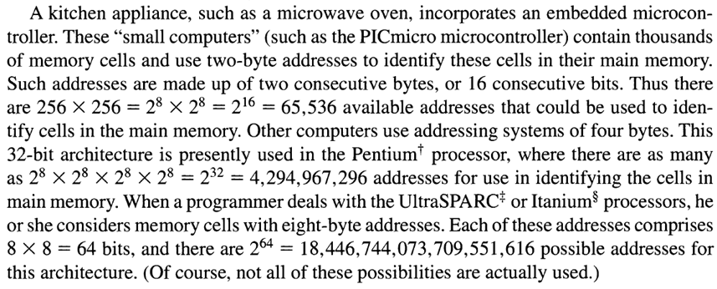
Fundamental Principles of Counting:

Slide 34
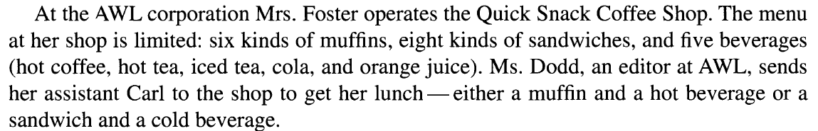
Fundamental Principles of Counting:

Slide 35
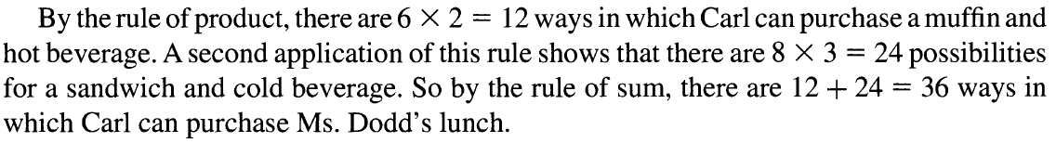
Fundamental Principles of Counting:

Slide 36
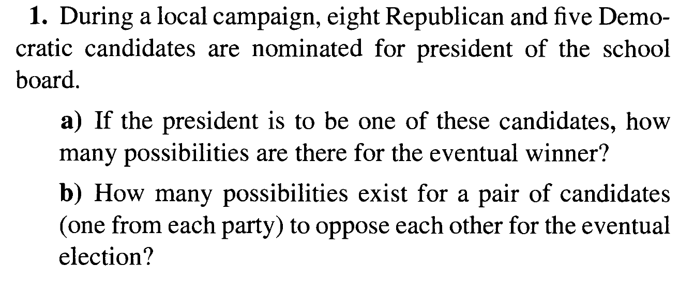
Fundamental Principles of Counting Exercise 1.1 and 1.2

Slide 37
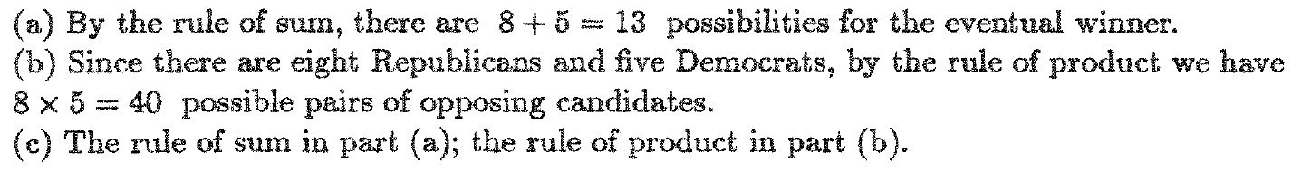
Fundamental Principles of Counting Exercise 1.1 and 1.2

Slide 38
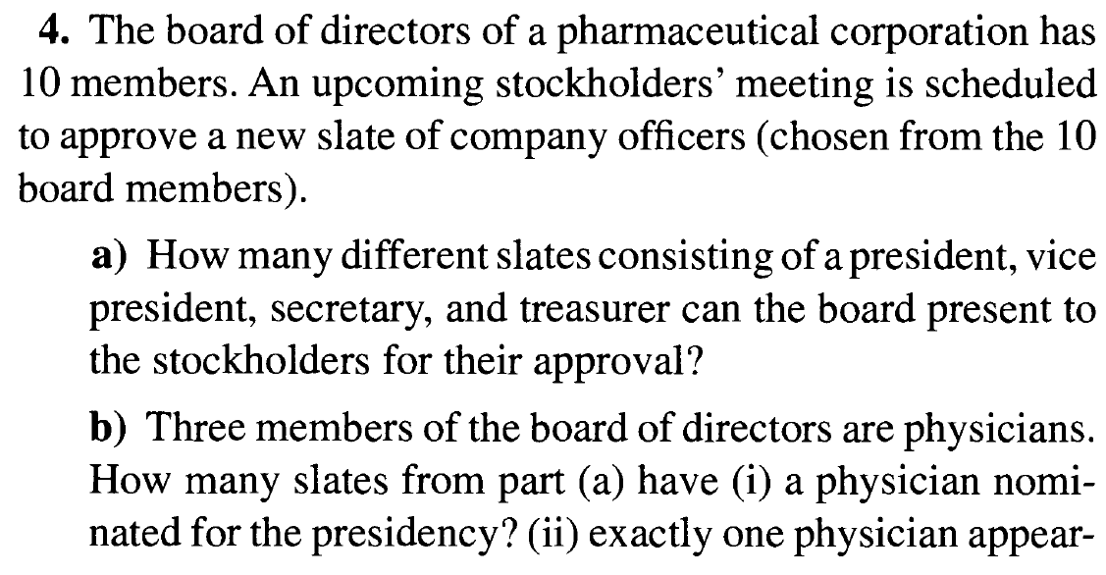
Fundamental Principles of Counting Exercise 1.1 and 1.2

Slide 39
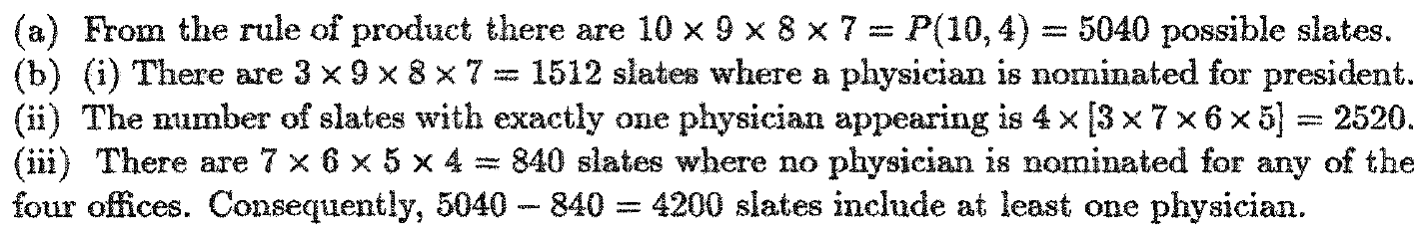
Fundamental Principles of Counting Exercise 1.1 and 1.2

Slide 40
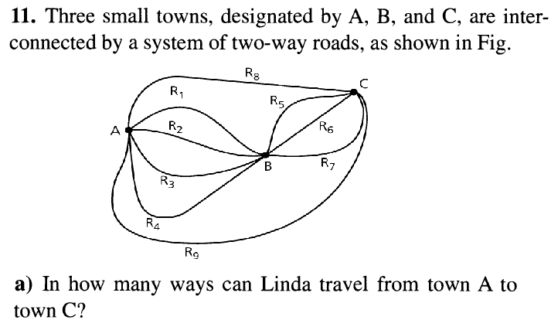
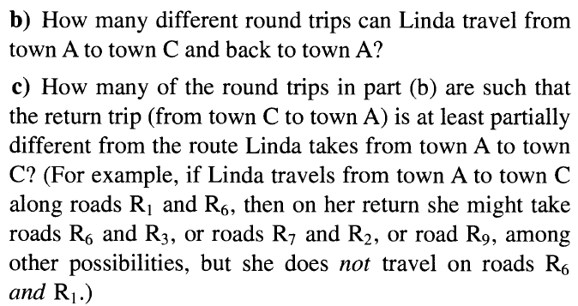
Fundamental Principles of Counting Exercise 1.1 and 1.2

Slide 41
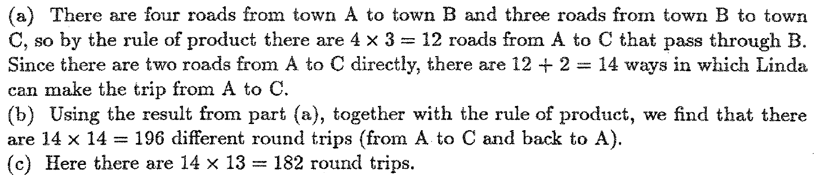
Fundamental Principles of Counting Exercise 1.1 and 1.2

Slide 42
DISCRETE MATHEMATICAL STRUCTURES
UNIT I
Fundamental Principles of Counting:
The Rule of Sum and Product √
Permutations, Combinations
The Binomial Theorem
Combinations with repetition

Slide 43
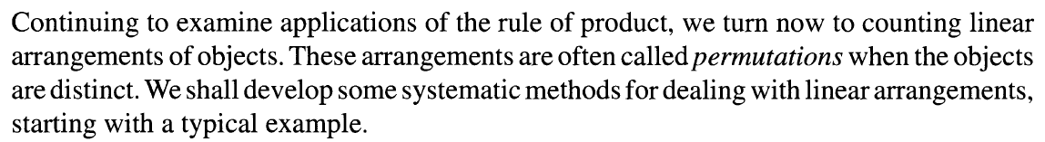
Fundamental Principles of Counting Permutations, Combinations

Slide 44
Fundamental Principles of Counting Permutations, Combinations

Slide 45
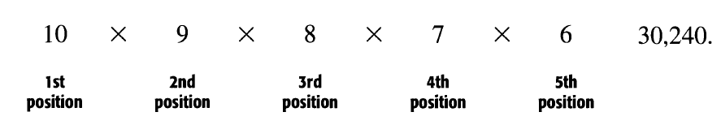
Fundamental Principles of Counting Permutations, Combinations

Slide 46
Fundamental Principles of Counting Permutations, Combinations
If five letters are to be chosen from the word COMPUTER, how many arrangements are there?

Slide 47
Fundamental Principles of Counting Permutations, Combinations
If five letters are to be chosen from the word COMPUTER, how many arrangements are there?
8 x 7 x 6 x 5 x 4 = 6720

Slide 48
Fundamental Principles of Counting Permutations, Combinations
Definition : n factorial (denoted by n!=) is defined by
0!=1; n!=n(n-1)(n-2)…(2)(1)
Definition : Given a collection of n distinct objects, any (linear) arrangement of these objects is called a permutation of the collection
The number of permutations of size r from a collection of n distinct objects is P(n, r)=n!/(n-r)!.
if repetitions are allowed: n^{r}

Slide 49
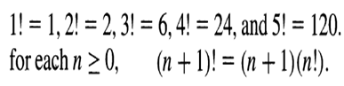
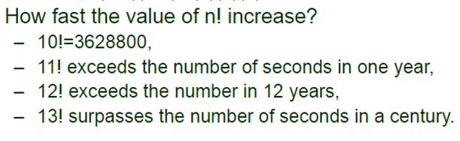
Fundamental Principles of Counting Permutations, Combinations

Slide 50
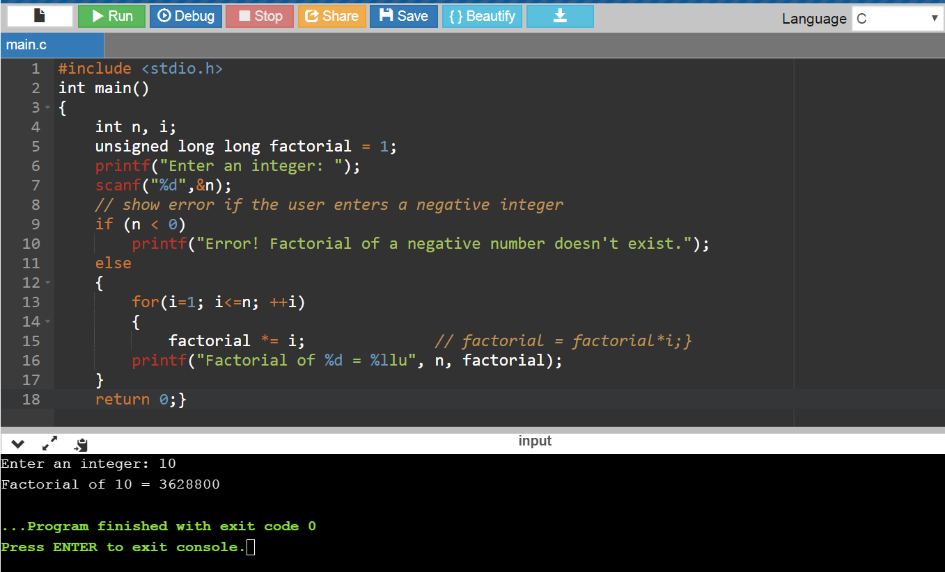
Fundamental Principles of Counting Permutations, Combinations

Slide 51
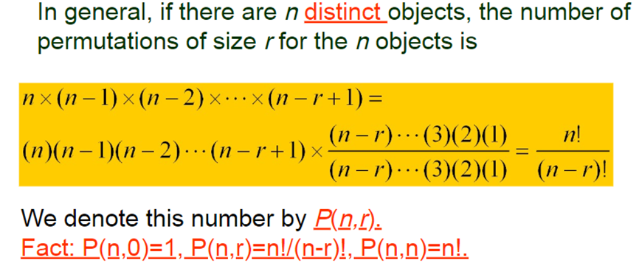
Fundamental Principles of Counting Permutations, Combinations

Slide 52
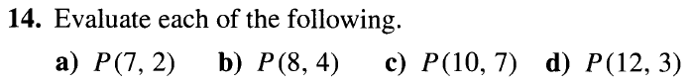
Fundamental Principles of Counting Permutations, Combinations

Slide 53
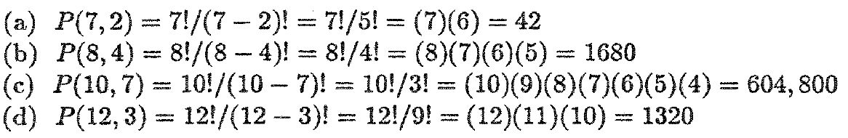
Fundamental Principles of Counting Permutations, Combinations

Slide 54
Fundamental Principles of Counting Permutations, Combinations

Slide 55
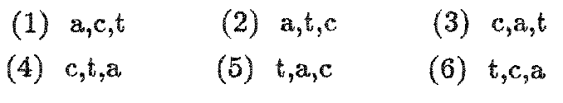
Fundamental Principles of Counting Permutations, Combinations

Slide 56
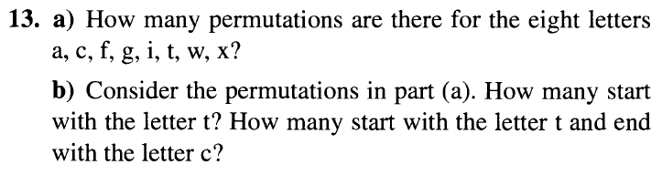
Fundamental Principles of Counting Permutations, Combinations

Slide 57
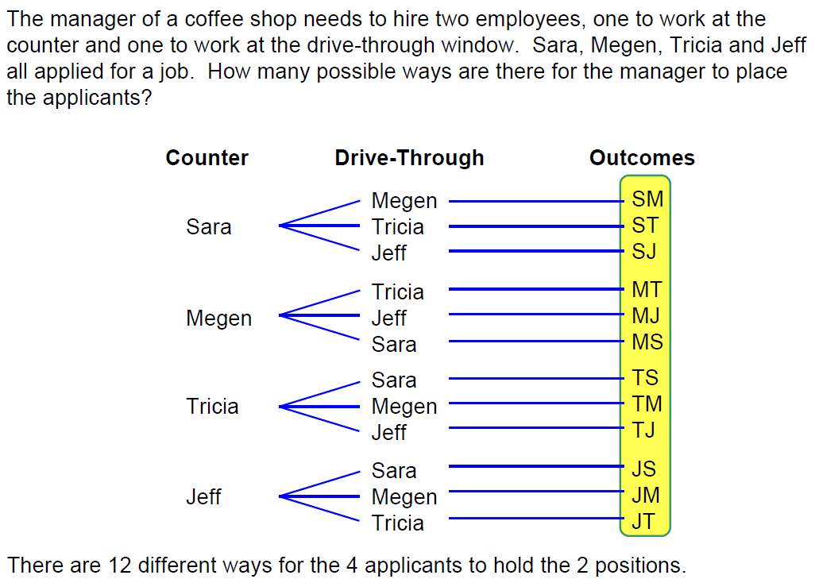
Fundamental Principles of Counting Permutations, Combinations

Slide 58
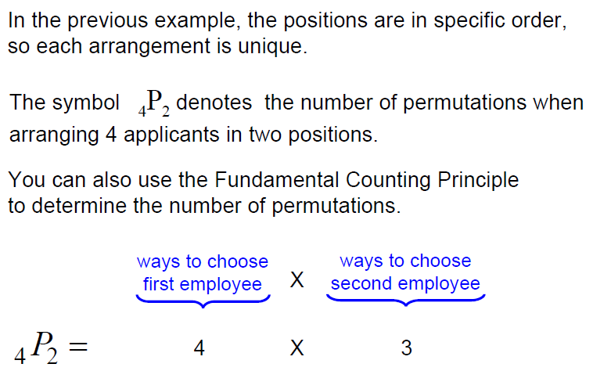
Fundamental Principles of Counting Permutations, Combinations

Slide 59
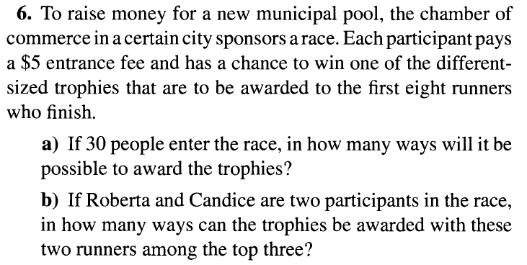
Fundamental Principles of Counting Permutations, Combinations

Slide 60
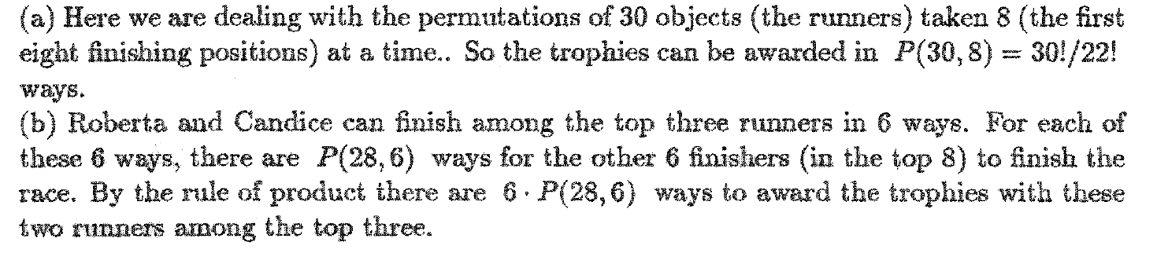
Fundamental Principles of Counting Permutations, Combinations

Slide 61
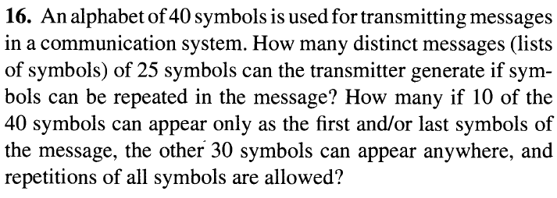
Fundamental Principles of Counting Permutations, Combinations

Slide 62
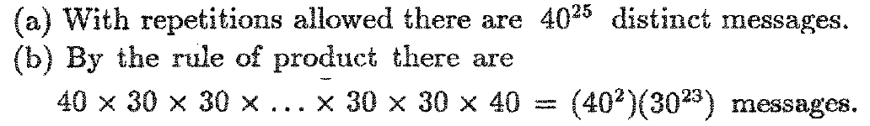
Fundamental Principles of Counting Permutations, Combinations

Slide 63
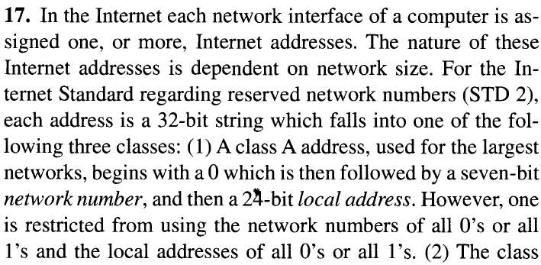
Fundamental Principles of Counting Permutations, Combinations

Slide 64
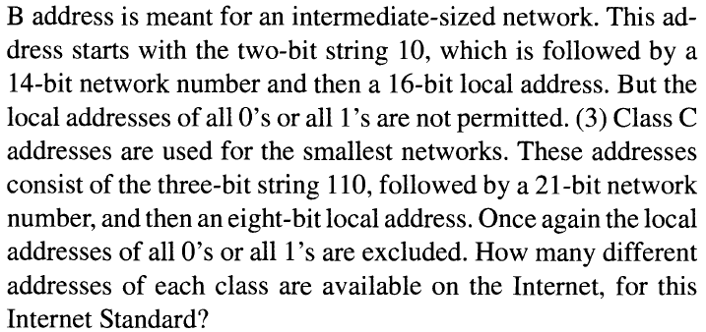
Fundamental Principles of Counting Permutations, Combinations

Slide 65
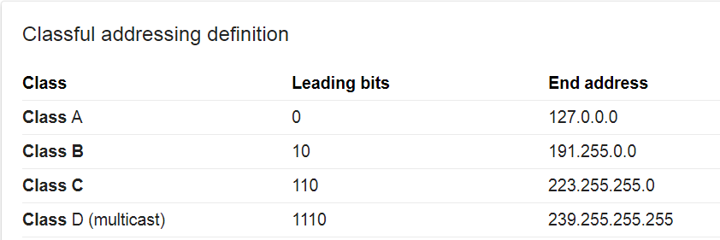
Fundamental Principles of Counting Permutations, Combinations

Slide 66
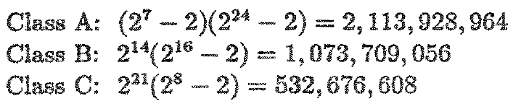
Fundamental Principles of Counting Permutations, Combinations

Slide 67
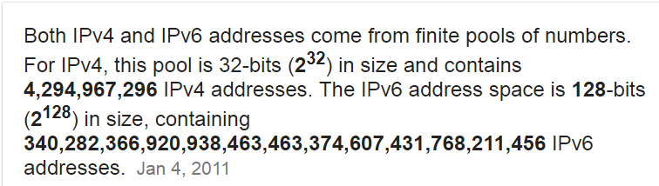
Fundamental Principles of Counting Permutations, Combinations

Slide 68
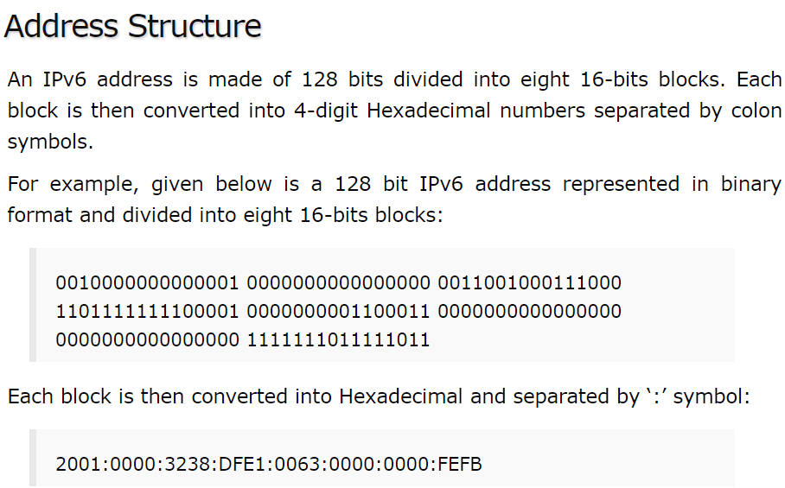
Fundamental Principles of Counting Permutations, Combinations

Slide 69
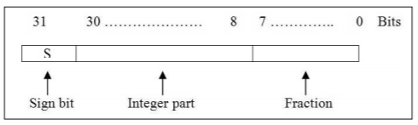
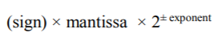
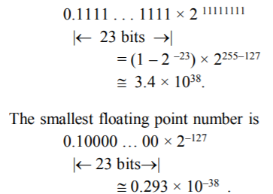
Fundamental Principles of Counting Permutations, Combinations

Slide 70
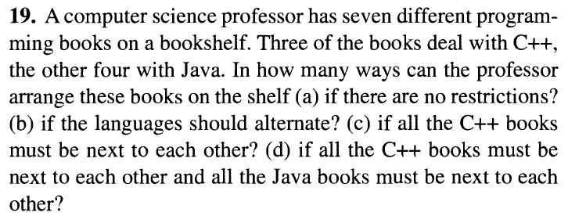
Fundamental Principles of Counting Permutations, Combinations

Slide 71
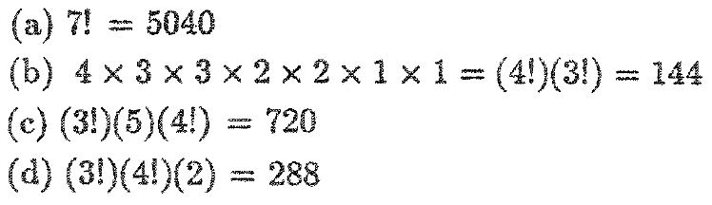
Fundamental Principles of Counting Permutations, Combinations

Slide 72
Fundamental Principles of Counting Permutations, Combinations
Permutation with repetition
If there are n objects with n₁ indistinguishable objects of a first type, n₂ indistinguishable objects of a second type,…, and n_{r} indistinguishable objects of an rth type, where n₁+n₂+…+n_{r}=n, then there are
arrangements of the given n objects.

Slide 73
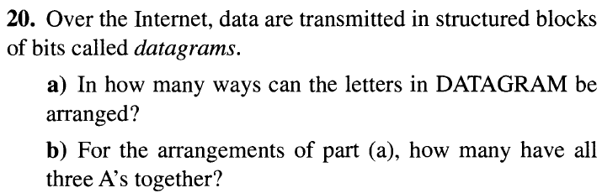
Fundamental Principles of Counting Permutations, Combinations

Slide 74
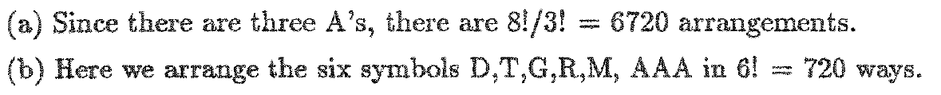
Fundamental Principles of Counting Permutations, Combinations

Slide 75

Fundamental Principles of Counting Permutations, Combinations

Slide 76

Fundamental Principles of Counting Permutations, Combinations

Slide 77
Fundamental Principles of Counting Permutations, Combinations

Slide 78

Fundamental Principles of Counting Permutations, Combinations

Slide 79

Fundamental Principles of Counting Permutations, Combinations

Slide 80
Fundamental Principles of Counting Permutations, Combinations

Slide 81

Fundamental Principles of Counting Permutations, Combinations

Slide 82

Fundamental Principles of Counting Permutations, Combinations

Slide 83

Fundamental Principles of Counting Permutations, Combinations

Slide 84

Fundamental Principles of Counting Permutations, Combinations

Slide 85

Fundamental Principles of Counting Permutations, Combinations

Slide 86

Fundamental Principles of Counting Permutations, Combinations

Slide 87

Fundamental Principles of Counting Permutations, Combinations

Slide 88

Fundamental Principles of Counting Permutations, Combinations

Slide 89

Fundamental Principles of Counting Permutations, Combinations

Slide 90
Fundamental Principles of Counting Permutations, Combinations
Circular permutation :
6 people are seated about a round table, how many
different circular arrangements are possible, if
arrangements are considered the same when
one can be obtained from the other by rotations?

Slide 91

Fundamental Principles of Counting Permutations, Combinations

Slide 92

Fundamental Principles of Counting Permutations, Combinations

Slide 93

Fundamental Principles of Counting Permutations, Combinations

Slide 94

Fundamental Principles of Counting Permutations, Combinations

Slide 95

Fundamental Principles of Counting Permutations, Combinations

Slide 96

Fundamental Principles of Counting Permutations, Combinations

Slide 97
Fundamental Principles of Counting Permutations, Combinations
Combinations
When dealing with any counting problem, we should ask ourselves about the importance of order in the problem. When order is relevant, we think in terms of permutations and arrangements and the rule of product. When order is not relevant, combinations could play a key role in solving the problem.

Slide 98
Fundamental Principles of Counting Permutations, Combinations
Select 3 cards from a deck of playing cards without replacement:
order of selection is relevant: P(52,3)=52 x 51x 50
order of selection is irrelevant: P(52,3)/3!=C(52,3)

Slide 99
Fundamental Principles of Counting Permutations, Combinations

Slide 100
Fundamental Principles of Counting Permutations, Combinations

Slide 101

Fundamental Principles of Counting Permutations, Combinations

Slide 102

Fundamental Principles of Counting Permutations, Combinations

Slide 103

Fundamental Principles of Counting Permutations, Combinations

Slide 104

Fundamental Principles of Counting Permutations, Combinations

Slide 105


Fundamental Principles of Counting Permutations, Combinations

Slide 106

Fundamental Principles of Counting Permutations, Combinations

Slide 107

Fundamental Principles of Counting Permutations, Combinations

Slide 108

Fundamental Principles of Counting Permutations, Combinations

Slide 109

Fundamental Principles of Counting Permutations, Combinations

Slide 110

Fundamental Principles of Counting Permutations, Combinations

Slide 111

Fundamental Principles of Counting Permutations, Combinations

Slide 112

Fundamental Principles of Counting Permutations, Combinations

Slide 113

Fundamental Principles of Counting Permutations, Combinations

Slide 114

Fundamental Principles of Counting Permutations, Combinations

Slide 115

Fundamental Principles of Counting Permutations, Combinations

Slide 116

Fundamental Principles of Counting Permutations, Combinations

Slide 117

Fundamental Principles of Counting Permutations, Combinations

Slide 118

Fundamental Principles of Counting Permutations, Combinations

Slide 119

Fundamental Principles of Counting Permutations, Combinations

Slide 120

Fundamental Principles of Counting Permutations, Combinations

Slide 121

Fundamental Principles of Counting Permutations, Combinations

Slide 122

Fundamental Principles of Counting Permutations, Combinations

Slide 123

Fundamental Principles of Counting Permutations, Combinations

Slide 124



Fundamental Principles of Counting Binomial Theorem

Slide 125
Fundamental Principles of Counting Binomial Theorem

Slide 126

Fundamental Principles of Counting Binomial Theorem

Slide 127
Fundamental Principles of Counting Binomial Theorem

Slide 128
Fundamental Principles of Counting Binomial Theorem

Slide 129
Fundamental Principles of Counting Binomial Theorem

Slide 130

Fundamental Principles of Counting Binomial Theorem

Slide 131

Fundamental Principles of Counting Binomial Theorem

Slide 132

Fundamental Principles of Counting Binomial Theorem

Slide 133

Fundamental Principles of Counting Multinomial Theorem

Slide 134

Fundamental Principles of Counting Multinomial Theorem

Slide 135

Fundamental Principles of Counting Multinomial Theorem

Slide 136

Fundamental Principles of Counting Multinomial Theorem

Slide 137

Fundamental Principles of Counting Multinomial Theorem

Slide 138

Fundamental Principles of Counting Multinomial Theorem

Slide 139

Fundamental Principles of Counting Multinomial Theorem

